Slide 1

UNIT-I
LEXICAL ANALYSIS
SCS1303 Compiler Design

Slide 2
UNIT 1 LEXICAL ANALYSIS
Structure of compiler
Functions and Roles of lexical phase
Input buffering
Representation of tokens using regular expression
Properties of regular expression
Finite Automata
Regular Expression to Finite Automata
NFA to Minimized DFA.
SCS1303 Compiler Design

Slide 3
Outline
Finite Automata
  Non-Deterministic Finite Automata(NFA)
  Deterministic Finite Automata(DFA)
  Conversion of Regular Expression to NFA(Thompson’s Construction)
  Conversion of NFA to DFA(Subset Construction Method)
  Conversion of DFA to Minimized DFA
Assignments
SCS1303 Compiler Design

Slide 4
Conversion Process
Regular Expression
NFA
DFA
Minimized DFA
Subset Construction Method
SCS1303 Compiler Design

Slide 5
Subset Construction Method
(NFA to DFA)
Input: An NFA N
Output: A DFA D accepting the same language
Method:
  Constructs a Transition table Dtran for D .
  Each DFA state is a set of NFA states.
  Constructs a transition table Dtran so that DFA D will simulate “in parallel” all possible moves NFA N can make on a given input string.
SCS1303 Compiler Design

Slide 6
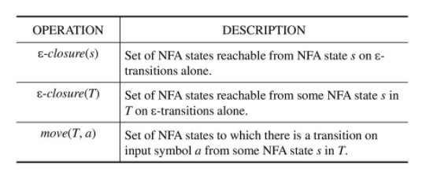
Subset Construction Method
Use the operations given in the table to keep track of sets of NFA states.
where,
s -> an NFA state
T -> a set of NFA states
a -> input symbol
SCS1303 Compiler Design

Slide 7
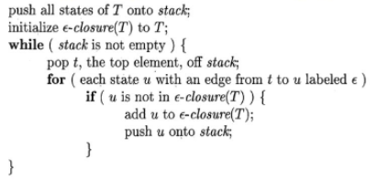
Computation of ε-closure
SCS1303 Compiler Design

Slide 8
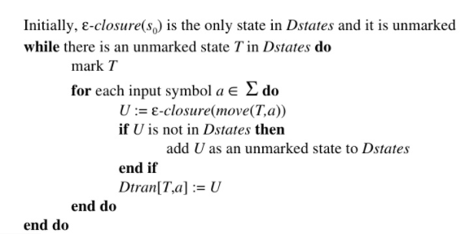
Subset Construction algorithm
s₀ represents the start state.
Dstates denotes the set of states of DFA D (each state in D corresponds to a set of NFA states)
Dtran represents the transition table for DFD D
SCS1303 Compiler Design

Slide 9
Conversion Process
Step 1:
NFA N for the Regular Expression (a|b)*abb
Step 2: Start state of equivalent DFA is ε-closure(0)
ε-closure(0) ={ 0,1,2,4,7} New DFA State
ε
a
2
3
ε
ε
start
0
ε
1
ε
a
b
b
6
7
8
9
10
ε
ε
4
5
b
ε
A
SCS1303 Compiler Design

Slide 10
Conversion Process
Step 2: Start state of equivalent DFA is ε-closure(0)
ε-closure(0) ={ 0,1,2,4,7} New DFA State
Start state of DFA:
Step 2.1: Compute ε-closure(move(A,a))
move(A,a) ={3,8}
ε-closure(move(A,a)) = ε-closure(3,8) = {3,8,6,7,1,2,4}
ε-closure(move(A,a)) ={1,2,3,4,6,7,8} New DFA State
Dtran[A,a]= B
A
start
A
B
a
B
start
A
SCS1303 Compiler Design

Slide 11
Conversion Process
Step 2.2: Compute ε-closure(move(A,b))
move(A,b) ={5}
ε-closure(move(A,b)) = ε-closure(5) = {5,6,7,1,2,4}
ε-closure(move(A,a)) ={1,2,4,5,6,7} New DFA State
Dtran[A,b]= C
C
Transition Table Dtran
a
B
DFA states | Input Symbols
 | a | b
A | B | C
B
C
start
A
b
C
SCS1303 Compiler Design

Slide 12
Conversion Process
Step 3: Compute Transition from state B on input symbol {a,b}
B = {1,2,3,4,6,7,8}
Step 3.1: Compute ε-closure(move(B,a))
move(B,a) ={3,8}
ε-closure(move(B,a)) = ε-closure(3,8) = {3,8,6,7,1,2,4}
ε-closure(move(B,a)) ={1,2,3,4,6,7,8} existing state
Dtran[B,a]= B
B
a
Transition Table Dtran
a
B
DFA states | Input Symbols
 | a | b
A | B | C
B | B
C
start
A
b
C
SCS1303 Compiler Design

Slide 13
Conversion Process
Step 3.2: Compute ε-closure(move(B,b))
move(B,b) ={5,9}
ε-closure(move(B,b)) = ε-closure(5,9) = {5,9,6,7,1,2,4}
ε-closure(move(B,b)) ={1,2,4,5,6,7,9} New DFA State
Dtran[B,b]= D
D
a
Transition Table Dtran
b
D
DFA states | Input Symbols
 | a | b
A | B | C
B | B | D
C
D
a
B
start
A
b
C
SCS1303 Compiler Design

Slide 14
Conversion Process
Step 4: Compute Transition from state C on input symbol {a,b}
C = {1,2,,4,5,6,7}
Step 4.1: Compute ε-closure(move(C,a))
move(C,a) ={3,8}
ε-closure(move(C,a)) = ε-closure(3,8) = {3,8,6,7,1,2,4}
ε-closure(move(C,a)) ={1,2,3,4,6,7,8} existing state
Dtran[C,a]= B
B
a
Transition Table Dtran
b
D
DFA states | Input Symbols
 | a | b
A | B | C
B | B | D
C | B
a
B
start
A
a
b
C
SCS1303 Compiler Design

Slide 15
Conversion Process
Step 4.2: Compute ε-closure(move(C,b))
move(C,b) ={5}
ε-closure(move(C,b)) = ε-closure(5) = {5,6,7,1,2,4}
ε-closure(move(C,b)) ={1,2,4,5,6,7} existing DFA State
Dtran[C,b]= C
C
a
Transition Table Dtran
DFA states | Input Symbols
 | a | b
A | B | C
B | B | D
C | B | C
D
b
D
a
B
start
A
a
b
C
b
SCS1303 Compiler Design

Slide 16
Conversion Process
Step 5: Compute Transition from state D on input symbol {a,b}
D = {1,2,,4,5,6,7,9}
Step 5.1: Compute ε-closure(move(D,a))
move(D,a) ={3,8}
ε-closure(move(D,a)) = ε-closure(3,8) = {3,8,6,7,1,2,4}
ε-closure(move(D,a)) ={1,2,3,4,6,7,8} existing state
Dtran[D,a]= B
B
a
DFA states | Input Symbols
 | a | b
A | B | C
B | B | D
C | B | C
D | B
B
b
D
a
start
A
a
a
b
C
b
SCS1303 Compiler Design

Slide 17
Conversion Process
Step 4.2: Compute ε-closure(move(D,b))
move(D,b) ={5,10}
ε-closure(move(D,b)) = ε-closure(5,10) = {5,10,6,7,1,2,4}
ε-closure(move(C,b)) ={1,2,4,5,6,7,10} New DFA State
Dtran[D,b]= E
E
a
DFA states | Input Symbols
 | a | b
A | B | C
B | B | D
C | B | C
D | B | E
E
B
b
D
a
start
A
a
a
b
b
C
E
b
SCS1303 Compiler Design

Slide 18
Step 6: Compute Transition from state E on input symbol {a,b}
E = {1,2,,4,5,6,7,10}
Step 6.1: Compute ε-closure(move(E,a))
move(E,a) ={3,8}
ε-closure(move(E,a)) = ε-closure(3,8) = {3,8,6,7,1,2,4}
ε-closure(move(E,a)) ={1,2,3,4,6,7,8} existing state
Dtran[E,a]= B
B
a
DFA states | Input Symbols
 | a | b
A | B | C
B | B | D
C | B | C
D | B | E
E | B
a
B
b
D
a
start
A
a
a
b
b
C
E
b
SCS1303 Compiler Design

Slide 19
Step 6.2: Compute ε-closure(move(E,b))
move(E,b) ={5}
ε-closure(move(E,b)) = ε-closure(5) = {5,6,7,1,2,4}
ε-closure(move(E,b)) ={1,2,4,5,6,7} existing state
Dtran[E,b]= C
C
a
a
DFA states | Input Symbols
 | a | b
A | B | C
B | B | D
C | B | C
D | B | E
E | B | C
B
b
D
a
start
A
a
a
b
b
C
b
E
b
SCS1303 Compiler Design

Slide 20
Step 7: No more new DFA states are formed.
Stop the subset construction method.
DFA for (a|b)*abb
DFA= Subset of NFA
A = {0,1,2,4,7} start state
B = {1,2,3,4,,6,7,8}
C = {1,2,4,5,6,7}
D = {1,2,4,5,6,7,9}
E = {1,2,4,5,6,7,10} State E contains the NFA accepting state(state 10)
a
a
B
b
D
a
start
A
a
a
b
b
C
E
b
b
SCS1303 Compiler Design

Slide 21
DFA for (a|b)*abb
a
a
b
D
b
start
a
B
E
A
a
a
b
b
C
b
DFA states | Input Symbols
 | a | b
A | B | C
B | B | D
C | B | C
D | B | E
E | B | C
Transition Table Dtran
SCS1303 Compiler Design

Slide 22
Next Topic:
Minimization of DFA
SCS1303 Compiler Design

Slide 23
Minimization of DFA
The process of reducing a given DFA to its minimal form is called as minimization of DFA.
It contains the minimum number of states.
The DFA in its minimal form is called as a Minimal DFA.
SCS1303 Compiler Design

Slide 24
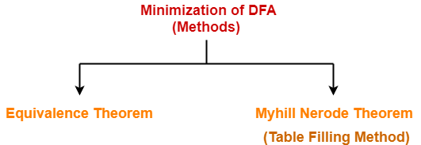
SCS1303 Compiler Design

Slide 25
Minimization of DFA Using Equivalence Theorem
Eliminate all the dead states and inaccessible states from the given DFA (if any).
Dead State
All those non-final states which transit to itself for all input symbols in ∑ are called as dead states.
Inaccessible State
All those states which can never be reached from the initial state are called as inaccessible states.
SCS1303 Compiler Design

Slide 26
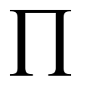
Minimized DFA
Input: A DFA D with set of states S,set of inputs ∑,transitions defined for all states and inputs ,start state s₀,and set of accepting states F.
Output: A minimized DFA M’ accepting the same language as D and having as few states as possible.
Method:
  Construct an initial partition of the set of states with two groups: the accepting states F and the non-accepting states S-F.
  Applying the algorithm to construct new partition.
  If M’ has a dead state, it can be removed.
    Dead state: a state that is not an accepting state and that has transition to itself on all input symbols .
    Also, remove any states not reachable from the start state.
    Any transition to a dead state become undefined.
SCS1303 Compiler Design

Slide 27

Partition Algorithm
for each group G of do
begin
  partition G into subgroups such that two states s and t
  of G are in the same subgroup if and only if for all
  input symbols a,states s and t have transition on a to states in the same group of ;
  replace G in by the set of all subgroups formed
  end
SCS1303 Compiler Design

Slide 28
1. Initial partition consists of two groups.
  set of non-accepting states and set of accepting states
  (ABCD)(E)
  2. As per the algorithm construct
    first consider the group (E) –set of accepting states
    this group consist of a single state ,so it cannot be split further.
    Consider the group (ABCD) –set of non-accepting states.
      On input a ,each state has a transition to B and hence remain in same group.
      On input b ,ABC remain in same group ,while D goes to E ,a member of another group.
    (ABC)(D)(E)
    (AC)(B)(D)(E)
Non-accepting states
DFA states | Input Symbols
 | a | b
A | B | C
B | B | D
C | B | C
D | B | E
E | B | C
accepting states
SCS1303 Compiler Design

Slide 29
Steps for Partition
Non-accepting states
Accepting states
(ABCD)
(E)
Non-accepting states
(ABC)
(D)
DFA states | Input Symbols
 | a | b
A | B | C
B | B | D
C | B | C
D | B | E
E | B | C
(AC)
(B)
accepting states
SCS1303 Compiler Design

Slide 30
DFA states | Input Symbols
 | a | b
A | B | C
B | B | D
C | B | C
D | B | E
E | B | C
Choose A as representative for group (AC)
DFA states | Input Symbols
 | a | b
A | B | A
B | B | D
D | B | E
E | B | A
Transition Table for reduced DFA
SCS1303 Compiler Design

Slide 31
Minimized DFA (a|b)*abb
DFA states | Input Symbols
 | a | b
A | B | A
B | B | D
D | B | E
E | B | A
b
a
start
A
a
B
b
D
b
E
a
a
b
SCS1303 Compiler Design

Slide 32
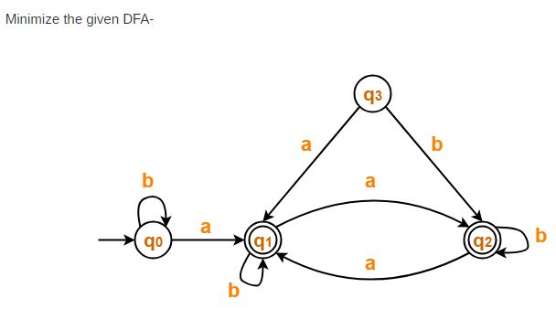
Example 1
SCS1303 Compiler Design

Slide 33
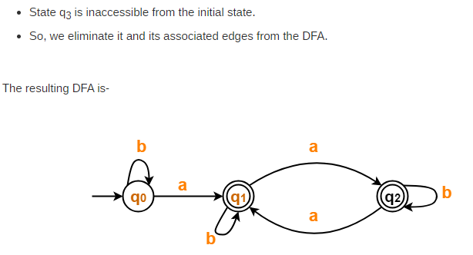
Solution 1
DFA states | Input Symbols
 | a | b
q₀ | q₁ | q₀
q₁ | q₂ | q₁
q₂ | q₁ | q₂
SCS1303 Compiler Design

Slide 34
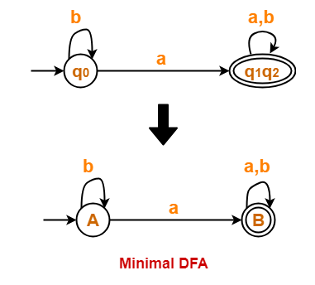
DFA states | Input Symbols
 | a | b
q₀ | q₁ | q₀
q₁ | q₂ | q₁
q₂ | q₁ | q₂
Partition=(q₀) (q₁ , q₂ )
DFA states | Input Symbols
 | a | b
q₀ | q₁ | q₀
q₁ | q₁ | q₁
SCS1303 Compiler Design

Slide 35
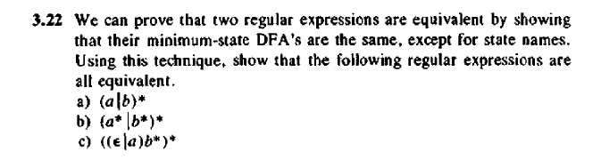
Equivalent REs
SCS1303 Compiler Design

Slide 36
1. (a|b)*
Step 1: RE to NFA
Step 2: NFA to DFA
Step 2.1: Start state of equivalent DFA is ε-closure(0)
ε-closure(0) ={ 0,1,2,4,7}
New DFA State
Start state of DFA:
ε
Step 2.2: Compute ε-closure(move(A,a))
move(A,a) ={3}
ε-closure(move(A,a)) = ε-closure(3) = {3,6,7,1,2,4}
={1,2,3,4,6,7}
New DFA State
Dtran[A,a]= B
a
ε
2
3
ε
start
ε
0
1
ε
6
7
ε
ε
4
b
5
B
ε
a
B
start
A
A
Transition Table Dtran
DFA states | Input Symbols
 | a | b
A | B
B
start
A
SCS1303 Compiler Design

Slide 37
ε
Step 2.4: Transition from B={1,2,3,4,6,7} Compute ε-closure(move(B,a))
move(B,a) ={3}
ε-closure(move(B,a))=ε-closure(3)
={1,2,3,4,6,7} Existing DFA State
Dtran[B,a]= B
A= { 0,1,2,4,7}
Step 2.3: Compute ε-closure(move(A,b))
move(A,b) ={5}
ε-closure(move(A,b))= ε-closure(5)={5,6,7,1,2,4}
={1,2,4,5,6,7} New DFA State
Dtran[A,a]= C
a
ε
2
3
ε
start
ε
0
1
ε
6
7
ε
ε
B
4
b
5
ε
a
a
B
start
A
b
C
Transition Table Dtran
C
DFA states | Input Symbols
 | a | b
A | B | C
B | B
C
a
B
start
A
b
C
SCS1303 Compiler Design

Slide 38
ε
Step 2.5: Transition from B={1,2,3,4,6,7} Compute ε-closure(move(B,b))
move(B,b) ={5}
ε-closure(move(B,b))=ε-closure(5)=C
Dtran[B,b]= C
a
ε
2
3
ε
a
start
ε
0
1
ε
6
7
a
B
ε
ε
start
4
b
5
A
b
ε
b
C
Transition Table Dtran
DFA states | Input Symbols
 | a | b
A | B | C
B | B | C
C
SCS1303 Compiler Design

Slide 39
ε
Step 2.7: Compute ε-closure(move(C,b))
move(C,b) ={5}
ε-closure(move(C,b))= C
Dtran[C,b]= C
Step 2.6: Transition from C={1,2,4,5,6,7} Compute ε-closure(move(C,a))
move(C,a) ={3}
ε-closure(move(C,a))= ε-closure(3)={3,6,7,1,2,4}={1,2,3,4,6,7}
Existing DFA State
Dtran[C,a]= B
a
ε
2
3
ε
start
ε
0
1
ε
6
7
a
ε
ε
4
b
5
a
B
start
ε
A
a
b
b
b
C
Transition Table Dtran
DFA states | Input Symbols
 | a | b
A | B | C
B | B | C
C | B | C
B
SCS1303 Compiler Design

Slide 40
Step 3: No more new DFA states are formed.
Stop the subset construction method.
DFA for (a|b)*
DFA= Subset of NFA
A = {0,1,2,4,7} start state and accepting state(state 0 and 7 )
B = {1,2,3,4,6,7} State B contains the NFA accepting state(state 7)
C = {1,2,4,5,6,7} State C contains the NFA accepting state(state 7)
a
a
B
start
A
a
b
b
C
b
SCS1303 Compiler Design

Slide 41
Minimized DFA
DFA states | Input Symbols
 | a | b
A | B | C
B | B | C
C | B | C
Non-accepting states
Accepting states
( )
(ABC)
All states remain in same group
accepting states
Therefore, consider one representative state.
A=B=C
a
a ,b
DFA states | Input Symbols
 | a | b
A | A | A
start
start
A
A
b
SCS1303 Compiler Design

Slide 42
2. (a*|b*)*
ε
Step 1: RE to NFA
Step 2: Start state of equivalent DFA is ε-closure(0)
ε-closure(0) ={ 0,1,11,2,6,3,5,10,7,9} ={0,1,2,3,5,6,7,9,10,11}
New DFA State Start state of DFA:
ε
ε
a
ε
2
3
4
5
ε
ε
ε
start
ε
0
1
ε
10
11
ε
ε
ε
ε
b
ε
6
7
8
9
ε
ε
A
start
A
SCS1303 Compiler Design

Slide 43
Step 2.1: Transition from A={0,1,2,3,5,6,7,9,10,11}
Compute ε-closure(move(A,a))
move(A,a) ={4}
ε-closure(move(A,a))= ε-closure(4)={4,5,3,10,11,1,2,6,7,9}
={1,2,3,4,5,6,7,9,10,11}
New DFA State
Dtran[A,a]= B
Step 2.2: Compute ε-closure(move(A,b))
move(A,b) ={8}
ε-closure(move(A,b))= ε-closure(8) ={8,9,7,10,11,1,2,6,3,5}
={1,2,3,5,6,7,8,9,10,11}
New DFA State
Dtran[A,b]= C
a
B
start
A
b
C
B
Transition Table Dtran
DFA states | Input Symbols
 | a | b
A | B | C
B
C
C
SCS1303 Compiler Design

Slide 44
a
Step 3.1: Transition from B={1,2,3,4,5,6,7,9,10,11}
Compute ε-closure(move(B,a))
move(B,a) ={4}
ε-closure(move(B,a))= ε-closure(4)={4,5,3,10,11,1,2,6,7,9}
={1,2,3,4,5,6,7,9,10,11}
Existing DFA State
Dtran[B,a]= B
Step 3.2: Compute ε-closure(move(B,b))
move(B,b) ={8}
ε-closure(move(B,b))= ε-closure(8) ={8,9,7,10,11,1,2,6,3,5}
={1,2,3,5,6,7,8,9,10,11}
Existing DFA State
Dtran[B,b]= C
a
B
start
A
b
b
C
B
Transition Table Dtran
DFA states | Input Symbols
 | a | b
A | B | C
B | B | C
C
C
SCS1303 Compiler Design

Slide 45
a
Step 4.1: Transition from C={1,2,3,5,6,7,8,9,10,11}
Compute ε-closure(move(C,a))
move(C,a) ={4}
ε-closure(move(C,a))= ε-closure(4)={4,5,3,10,11,1,2,6,7,9}
={1,2,3,4,5,6,7,9,10,11}
Existing DFA State
Dtran[C,a]= B
Step 4.2: Compute ε-closure(move(C,b))
move(C,b) ={8}
ε-closure(move(C,b))= ε-closure(8) ={8,9,7,10,11,1,2,6,3,5}
={1,2,3,5,6,7,8,9,10,11}
Existing DFA State
Dtran[C,b]= C
a
B
start
A
b
a
b
C
B
b
Transition Table Dtran
DFA states | Input Symbols
 | a | b
A | B | C
B | B | C
C | B | C
C
SCS1303 Compiler Design

Slide 46
Step 5: No more new DFA states are formed.
Stop the subset construction method.
DFA for (a*|b*)*
DFA= Subset of NFA
A = {0,1,2,3,5,6,7,9,10,11} start state and accepting state(state 0 and 11 )
B = {1,2,3,4,5,6,7,9,10,11} B contains the NFA accepting state(state 11)
C = {1,2,3,5,6,7,8,9,10,11} C contains the NFA accepting state(state 11)
a
a
B
start
A
b
a
b
C
b
SCS1303 Compiler Design

Slide 47
Minimized DFA
DFA states | Input Symbols
 | a | b
A | B | C
B | B | C
C | B | C
Non-accepting states
Accepting states
( )
(ABC)
All states remain in same group
accepting states
Therefore, consider one representative state.
A=B=C
a
a ,b
DFA states | Input Symbols
 | a | b
A | A | A
start
start
A
A
b
SCS1303 Compiler Design

Slide 48
((ε|a)b*)* ?
Will this Regular Expression produce an equivalent minimized DFA?
Try it.......
SCS1303 Compiler Design

Slide 49
THANK YOU
SCS1303 Compiler Design

